Slide 1


Slide 2

Table of Contents
Page | Topic
3 | Graduation Requirements
6-9 | SAT/ACT Date information and Test Prep
10 | Bright Futures Requirements
11 | Volunteer and Paid Work Requirements
12-17 | Senior Checklist
18-20 | Important College Terms
21 | SSAR Information
22 | FAFSA Information
23 | State University Information
24-26 | Florida’s Private College System
27 | Xello Information
28 | Wilton Simpson Tech
30 | Pasco Hernando State College
31 | Scholarship Information
32 | Important Websites
33 | Military Sites / ROTC
34-37 | NCAA Information
38 | NAIA Information

Slide 3

Graduation Requirements for Florida's Statewide Assessments Here are some useful links posted on the FLDOE website:
FL Statue 1003.4282: Requirements for a standard high school diploma
Statutes & Constitution :View Statutes : Online Sunshine (state.fl.us)
FL Statue 1008.22 Student assessment program for public schools
FAST Assessments
Florida Statue 1008.22 Student assessment program for public schools
Notes:
Links are from: DOE page: Graduation Requirements for Florida's Statewide Assessments (fldoe.org)

Slide 4
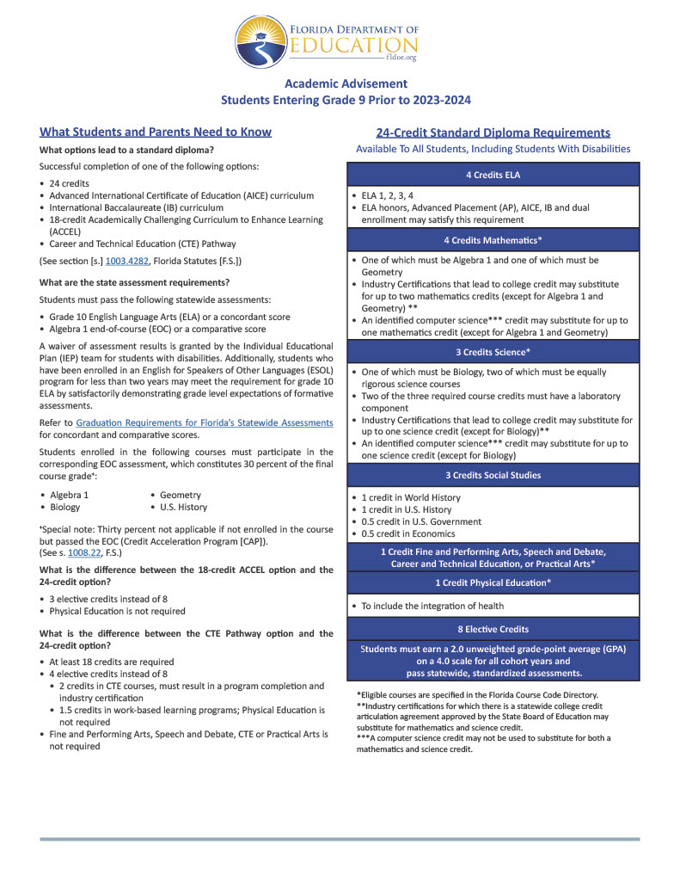
FLDOE ACADEMIC ADVISEMENT
Link to: Requirements for a standard high school diploma FS 1003.4282
Link to: Graduation Requirements for Florida’s Statewide Assessments
Link to: Link to F S 1008.22
Notes:
Grad req for FL Statewide Assessments
http://www.leg.state.fl.us/statutes/index.cfm?mode=View%20Statutes&SubMenu=1&App_mode=Display_Statute&Search_String=1003.4282&URL=1000-1099/1003/Sections/1003.4282.html

Slide 5

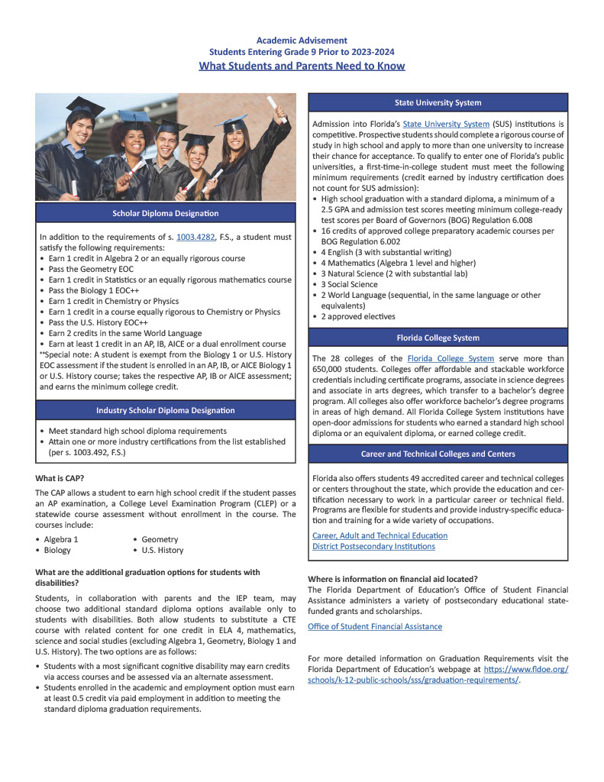
FLDOE ACADEMIC ADVISEMENT Continued
Link to: Florida's State University System
Link to: Florida College System
Link to: FS 1003.4282
Link to: Graduation Requirements
Link to: FS 1003.4282

Slide 6
SAT VS. ACT
SAT | ACT
Cost: $68.00 Late Registration: Additional $30.00 | Cost: $68.00 (including essay: $93.00) Late Registration: Additional $38.00
General Information: Non-multiple-choice answers included No guessing penalty Testing time -3 hours, 3 hours and 50 minutes with essay | General Information: Entirely multiple choice No guessing penalty Testing time – 2 hours and 55 minutes, 3 hours and 40 minutes with essay
Test Contents: EVIDENCE-BASED READING AND WRITING Reading Test Writing and Language MATHEMATICS Problem Solving and Data Analysis- Focuses on quantitive literacy Heart of Algebra- Focuses on the mastery of linear functions and systems Passport to Advanced Math- Questions require the manipulation and answering of complex equations Additional Topics in Math- Geometric and trigonomic skills most relevant to college and career readiness | Test Contents: ENGLISH Production of writing. Knowledge of language and Statistics and probability READING Key ideas and details, craft and structure and integration of knowledge and ideas SCIENCE Interpretation of data, scientific investigation and evaluation of models, interferences and experimental results WRITING (OPTIONAL) Writing skills ** A student’s score on the writing test have no effect on the score of any ACT Assessment Test or the Composite score.
Scoring: | Scoring:
English | 1-36
Mathematics | 1-36
Reading | 1-36
Science | 1-36
Composite (average of E,R & S tests)/Maximum Score | 1-36
Writing (optional) Writing sub score | 2-12
STEM score | 1-36
ELA score | 1-36
Evidence-Based Reading /Writing | 200-800
Math | 200-800
Maximum Score | 1600

Slide 7
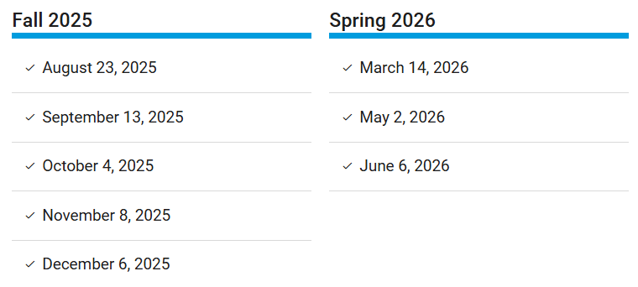
SAT Dates & Deadlines
Register link: https://mysat.collegeboard.org/login
https://satsuite.collegeboard.org/sat/device-lending
Notes:
https://satsuite.collegeboard.org/sat/dates-deadlines

Slide 8
ACT Test Dates
Test Date | Regular Registration Deadline Late Fee Applies After This Date | Late Registration Deadline | Photo Upload and Standby Deadline
September 6, 2025 | August 1 | August 19 | August 29
October 18, 2025 | September 12 | September 30 | October 10
December 13, 2025 | November 7 | November 24 | December 5
February 14, 2026 | January 7 | January 21 | February 6
April 11, 2026 | March 6 | March 24 | April 3
June 13, 2026 | May 8 | May 27 | June 5
July 11, 2026* | June 5 | June 24 | July 3
Use the following link for more information: www.act.org
Notes:
https://satsuite.collegeboard.org/sat/dates-deadlines

Slide 9

ACT/SAT Test Prep
http://www.satpractice.org
College Board - SAT, AP, College Search and Admission Tools
ACT Learning Resources - ACT Solutions | ACT
ACT Products and Services | ACT
Number2 - Online Test Prep Courses for College Readiness & Career Development
SAT vs ACT - Which Test Should You Take? | Kaplan Test Prep (kaptest.com)
Free SAT Practice Test & Questions | Kaplan Test Prep (kaptest.com)
ACT Prep - Courses & Online Test Prep | Kaplan Test Prep (kaptest.com)
Official Digital SAT® Prep | Khan Academy
Notes:
https://satsuite.collegeboard.org/sat/dates-deadlines

Slide 10
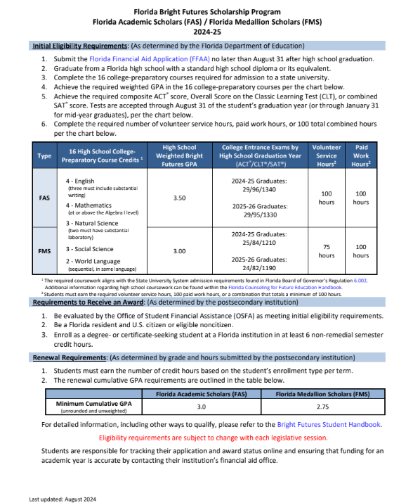
Florida Bright Futures Scholarship Program
Notes:
https://satsuite.collegeboard.org/sat/dates-deadlines

Slide 11
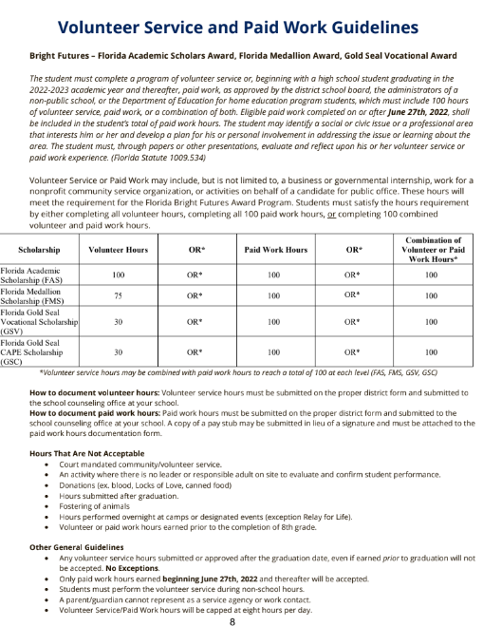
Volunteer Service and Paid Work Guidelines
Notes:
https://satsuite.collegeboard.org/sat/dates-deadlines

Slide 12
Senior Checklist
AUGUST
Complete college research and make a final list of four or more to which you plan to apply (resources available on Xello)
Gather college application information
Determine application options ( early decision, early action, or regular decision)
Begin essays for college applications
Register for ACT, SAT, CLT
Meet with college representatives who are visiting your school
Explore scholarships on Xello and the HCEF webpage
https://hernandoeducationfoundation.org/scholarships/
Submit any volunteer service done over the summer
SEPTEMBER
Explore the State University System College Admission Requirement Matrix on the website below or see your counselor
https://www.flbog.edu/resources/admissions-tour/
Gather letter of recommendation
Continue to work on applications
Register for SAT, ACT, CLT
Meet with college representatives who are visiting your school
Check with school counselor of JROTC regarding the ASVAB date at your school if you are interested in the military
Continue to submit volunteer service or paid work hours logs
Notes:
https://satsuite.collegeboard.org/sat/dates-deadlines

Slide 13
Senior Checklist
OCTOBER
Attend district hosted college fair (10/9/25 at NCTHS)
Continue to apply for college and universities
Complete your SSAR- if required by the university
Continue to check HCEF website and Xello for scholarships
Check out early action deadlines for Florida universities
FSU, UCF- 10/15
UF, UNF- 11/1
USF priority decision 11/1
FIU -10/23
Continue to submit volunteer service or paid work hours logs
Continue to register for SAT, ACT, CLT
Apply for Florida Financial Aid (Bright Futures) at
https://www.floridastudentfinancialaidsg.org/SAPHome/SAPHome?url=home
Explore financial aid and FAFSA resources at
https://studentaid.gov/
***Dates are subject to change
NOVEMBER
Be aware of university application deadlines! Many are 11/1
Continue to check HCEF website and Xello for scholarships
Continue to apply for college and universities
Continue to submit volunteer service or paid work hours logs
Continue to register for SAT, ACT, CLT
Notes:
https://satsuite.collegeboard.org/sat/dates-deadlines

Slide 14
Senior Checklist
DECEMBER
Continue to register for SAT, ACT and CLT
Continue to apply for scholarships
Continue to submit volunteer service and work hours
Continue to apply for universities
APPLY for FAFSA
https://studentaid.gov/
JANUARY
Continue to register for SAT, ACT and CLT
Continue to apply for scholarships
Continue to submit volunteer service and work hours
Continue to apply for universities
Notes:
https://satsuite.collegeboard.org/sat/dates-deadlines

Slide 15
Senior Checklist
FEBRUARY/MARCH
Attend college fair at Springstead
Check the status of your financial aid awards by accessing your online college accounts
If needed contact the college’s financial aid offices to determine if additional financial aid documents are required
Update the FAFSA with new tax information if needed
Apply for housing and pay deposits as applicable (dates vary)
Register for ACT/SAT/CLT if scores still needed for Bright Futures etc. Be aware of deadlines!
Continue to submit volunteer service and work hours
Continue to apply for scholarships
Update SSAR to include any semester 1 test score and grades
Notes:
https://satsuite.collegeboard.org/sat/dates-deadlines

Slide 16
Senior Checklist
APRIL
Check the status of your financial aid awards by accessing your online college accounts
Schedule college orientation (dates may vary)
If needed, contact the college’s financial aid offices to determine if additional financial aid documents are required
Register for ACT/SAT/CLT if scores still needed for Bright Futures etc. Be aware of deadlines!
Continue to submit volunteer service and work hours
Continue to apply for scholarships
Update SSAR to include any semester 1 test score and grades
Notes:
https://satsuite.collegeboard.org/sat/dates-deadlines

Slide 17
Senior Checklist
MAY
Commit to the college that you will attend and pay deposits applicable.
Return your college’s financial aid award letter indicating the awards you are accepting and declining
Attend college orientation sessions (dates may vary)
Submit volunteer service and work hours before graduation
Continue to apply for scholarships
Register for ACT/SAT/CLT if scores still needed for Bright Futures etc. Be aware of deadlines!
Update Bright Futures application with the final college selection if needed.
JUN/JUL
Attend college orientation sessions (dates may vary)
Continue to register for SAT, ACT and CLT
Continue to apply for scholarships
Request dual enrollment transcripts from PHSC and/or AP scores from CollegeBoard to be sent to the college you will attend.
Continue to monitor Bright Futures status
Register for ACT/SAT/CLT in JUNE, if scores still needed for Bright Futures etc. Be aware of deadlines!
Notes:
https://satsuite.collegeboard.org/sat/dates-deadlines

Slide 18
IMPORTANT COLLEGE TERMS
ACCREDITATION: Recognition of a college or university by any of the regional or national accrediting bodies, indicating that the institution as a whole has been judged to be meeting its objectives.
CANDIDATES REPLY DATE: A policy among subscribing institutions that permits students to wait until May 1st to choose, without penalty, among offers of admissions/financial aid. (This does not include candidates accepted
under the Early Decision plan.)
COALITION APPLICATION: A standard application that is accepted by 140 colleges and universities. Some schools will accept the Coalition application in addition to current applications, while other schools will require all students to use the Coalition application.
COMMON APPLICATION: A standard application form that is accepted by about 500 colleges in lieu of their own form. Available at www.commonapp.org. If you are applying to a college that requires the Common Application, you must use this form in order to send transcripts and recs electronically.
CSS/FINANCIAL AID PROFILE: A financial aid form produced by the College Board that is required for students seeking aid at approximately 10% of the nation’s universities (including most highly selective institutions). Check colleges’ websites for requirement information. Available at www.collegeboard.org.
DEFERRED ADMISSIONS: The practice of some colleges allowing an accepted student to postpone enrollment for one year.
DEFERRED DECISION: The practice of some colleges of holding an applicant’s record to review again with the next applicant pool. A student who is deferred is neither accepted nor rejected. Most schools require 1st semester senior year grades and allow additional recommendations in the 2nd evaluation. Students should contact the admissions office to discuss ways to enhance the application and what should be submitted.
DEMONSTRATED NEED: The difference between the Expected Family Contribution and the total cost of attendance at a particular institution.

Slide 19
IMPORTANT COLLEGE TERMS
EARLY ACTION: An application process that permits students to submit an application to an institution of preference early in the senior year and receive a decision well in advance of the normal response dates in the spring. The candidate is NOT committed to enroll at that institution.
EARLY ADMISSION: Admitting students of superior ability into college courses and programs before they have completed their high school diploma. This type of application must be filed in the junior year.
EARLY DECISION: An application process in which a commitment is made by a student to the institution that, if admitted, the student WILL enroll. Only a student who can make a deliberate and well-reasoned first choice decision should apply early decision.
FAFSA (FREE APPLICATION FOR FEDERAL STUDENT AID): The financial aid form produced by the federal government that is required for nearly all colleges. Students and parents should fill out the form starting October 1st at www.fafsa.gov.
HONORS PROGRAM: Any program offering an opportunity for superior students to enrich their educational experience through independent, advanced, or accelerated study
MODIFIED ROLLING ADMISSIONS: The practice of institutions reviewing applicant pools several times throughout the year. The school will post several deadlines and the dates in which those applications will be reviewed.
NCAA INITIAL ELIGIBILITY CERTIFICATION: In order to participate in intercollegiate sports at NCAA Div. I, II, or III colleges, student-athletes must submit their high school transcript and ACT/SAT scores to the NCAA Initial Eligibility Clearinghouse. When registering for either test, students should enter “9999” as one of their college choices to have test scores sent to the Clearinghouse.
NEED BLIND ADMISSIONS: The term that applies to colleges that make decisions without regard to the financial circumstances of the applicants. Colleges with need-blind admissions do not necessarily offer aid to meet the full need of all accepted applicants.

Slide 20
IMPORTANT COLLEGE TERMS
OPEN ADMISSIONS: The policy of some colleges of admitting virtually all high school graduates, regardless of
academic qualifications such as high school grades and admission test scores. Often only a high school diploma is required. (Community Colleges generally fall under an open admissions classification.)
ROLLING ADMISSIONS: An admissions procedure by which the college considers each application as soon as required materials have been received. The college then notifies each applicant of acceptance or rejection as soon as possible.
SAR (STUDENT AID REPORT): A form sent to families in response to submission of the Free Application for
Federal Student Aid that includes the Expected Family Contribution, a figure that may be modified at colleges
that use institutional methodology.
SAT SUBJECT TESTS: One-hour tests available in 18 subjects. These tests are required by the most selective colleges. Check the admissions page of the colleges’ websites. Typically, colleges recommend sending 2-3 subject test scores. For a complete list of subject tests offered and to register, visit www.collegeboard.org. Students are encouraged to take their “best” subjects to show the college their strengths.
SELF-HELP AID: The portion of a financial aid package consisting of loans and wages from a work-study job.
TEST OPTIONAL: A term used by institutions that means it is not mandatory for students to submit their SAT
and/or ACT scores as a part of their application.
WAITLIST: A term used by institutions to describe a process by which they may initially delay offering or
denying admissions during the regular decision pool. These students may be considered if space is available
after admitted students have indicated whether or not they will attend.

Slide 21

Self-Reporting Coursework (SSAR)
Begin here: Self-reported academic record
SELF-REPORTING COURSEWORK (SSAR)
SSAR is a student self-reported academic record that lists the classes and associated grades that have been attempted, or will be attempted. For high school and/or college credit. It replaces the high school and college transcripts used by a few college admissions offices (ex. UF, FSU, FAU) during the initial review process.
Official Transcripts win only be requested and sent AFTER graduation to validate what is entered on the SSAR. Please research which colleges on your list require you to submit o SSAR and which require an official transcript. Since accuracy is critical, you are advised to have a copy or your high school summary sheet (unofficial transcript) available to use as a reference when filling out the SSAR.
TIPS:
District GPA = Weighted GPA
HCPS does an exact rank, not a percentile [example: 175 (your rank) /592 (total number of seniors) ]
You should list the high school you are graduating from and au of the courses listed on your summary sheet regardless of how many different schools you attended.
All senior year courses must be included and listed as "in progress." If you are unsure of what courses you will be taking second semester, provide your best estimate and update the SSAR If anything changes. If your schedule changes, you must immediately update your SSAR. To make changes to the SSAR, simply login to the SSAR website with the email address and password used to create your original SSAR.
Every course listed on your summary sheet must be entered in the SSAR (including middle school, online, dual enrollment,. etc.) This also applies to any courses of these types that the student is taking in their Senior year.
Most of the grades on your summary sheet are semester grades. If there is a course that is a single grade for one credit, enter that grade twice (once for first semester and once for second semester). This also applies to dual enrollment courses that were awarded a full high school (1.0) credit.
Summer courses: You will record the course and grade in the preceding school year. For example, If you took a course between the 9th and 10th grades, you would enter the course in the 9th grade.
If you are unsure of what subject area a course falls into, please reach out to the-admissions office of your college(s).
After you complete and submit your SSAR on the SSAR web1it1, you are NOT DONE. It must be individually linked through the application status check portal at each respective college that requires it.
Some of these tips were copied from the SSAR FAQ sections of UF and FSU's websites. Please visit these websites for how-to videos and the most up to date information.
Notes:
Which Colleges/Universities Accept The SSAR/SRAR? – Support Center (zendesk.com)

Slide 22

Financial Aid (FAFSA)
Completing the Free Application for Federal Student Aid (FAFSA®) form allows you to be considered for federal student aid. In addition, states and colleges use FAFSA information to award their own grants, scholarships, and loans. But, since some aid is limited, you have to meet the deadlines!
2025–26 FAFSA® Deadlines
Federal Deadlines
The FAFSA form must be submitted by 11:59 p.m. Central time (CT) on June 30, 2026. Any corrections or updates must be submitted by 11:59 p.m. CT on Sept. 12, 2026.
Use the following link to start your FAFSA application:
FAFSA online application
FAQ’s
Types of aid
Notes:
FAFSA® Application | Federal Student Aid

Slide 23
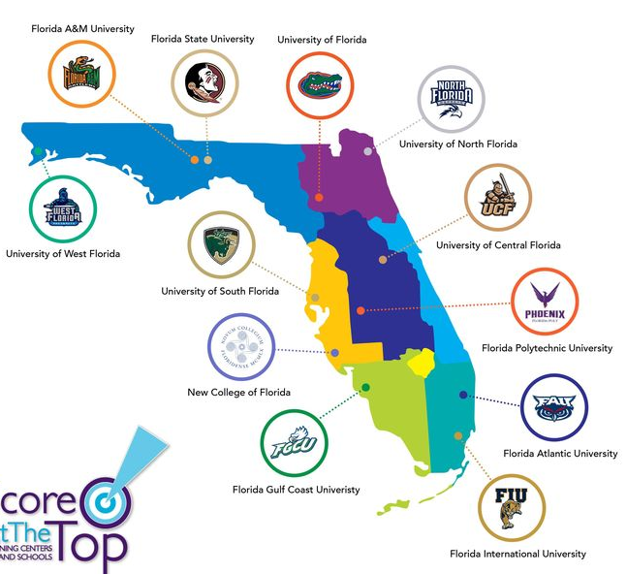

State University System Map of Florida
Florida Agricultural and Mechanical University
Florida Atlantic University
Florida Gulf Coast University
Florida International University
Florida Polytechnic University
Florida State University
New College of Florida
University of Florida
University of Central of Central Florida
University of North Florida
University of South Florida
University of West Florida

Slide 24
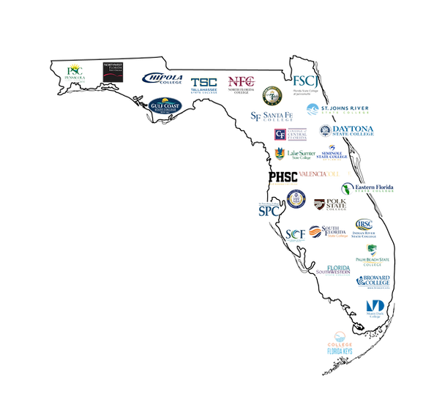
Florida College System
Broward College
Chipola College
College of Central Florida
College of the Florida Keys
Daytona State College
Eastern Florida State College
Florida Gateway College
Florida SouthWestern State College
Florida State College at Jacksonville
Gulf Coast State College
Hillsborough Community College
Indian River State College
Lake-Sumter State College
Miami Dade College
North Florida College
Northwest Florida State College
Palm Beach State College
Pasco-Hernando State College
Pensacola State College
Polk State College
St. Johns River State College
St Petersburg College
Santa Fe College
Seminole State College of Florida
South Florida State College
State College of Florida, Manatee-Sarasota
Tallahassee Community College
Valencia College
Notes:
https://www.floridacollegesystemfoundation.org/

Slide 25
Florida’s Private Colleges and Universities
Adventist University of Health Sciences www.adu.edu Orlando
Ave Maria University www.avemaria.edu Ave Maria
Barry University www.barry.edu Miami Shores
Beacon College www.beaconcollege.edu Leesburg
Bethune Cookman University www.cookman.edu Daytona Beach
Eckerd College www.eckerd.edu St. Petersburg
Edward Waters College www.ewc.edu Jacksonville
Embry Riddle Aeronautical University www.erau.edu Daytona Beach
Everglades University www.evergladesuniversity.edu Boca Raton
Flagler College www.flagler.edu St. Augustine
Florida College www.floridacollege.edu Temple Terrace
Florida Institute of Technology www.fit.edu Melbourne
Florida Memorial University www.fmuniv.edu Miami
Florida Southern College www.flsouthern.edu Lakeland
Hodges University www.hodges.edu Naples
Jacksonville University www.ju.edu Jacksonville
Johnson University www.johnsonu.edu Kissimmee
Johnson & Wales University www.jwu.edu North Miami
Keiser University www.keiseruniversity.edu Fort Lauderdale
Lynn University www.lynn.edu Boca Raton
Miami Int’l University of Art & Design www.artsinstitutes.edu/miami Miami
Northwood University www.northwood.edu Tampa
Nova Southeastern University www.nova.edu Fort Lauderdale
Palm Beach Atlantic College www.pba.edu West Palm Beach
Notes:
https://satsuite.collegeboard.org/sat/dates-deadlines

Slide 26
Florida’s Private Colleges and Universities
Ringling College of Art & Design www.ringling.edu Sarasota
Rollins College www.rollins.edu Winter Park
Southeastern University www.seu.edu Lakeland
Saint Leo University www.saintleo.edu Saint Leo
St. Thomas University www.stu.edu St. Thomas
Stetson University www.stetson.edu Deland
University of Miami www.miami.edu Coral Gables
University of Tampa www.ut.edu Tampa
Warner Southern College www.warner.edu Lake Wales
Webber International University www.webber.edu Babson Park
Notes:
https://satsuite.collegeboard.org/sat/dates-deadlines

Slide 27


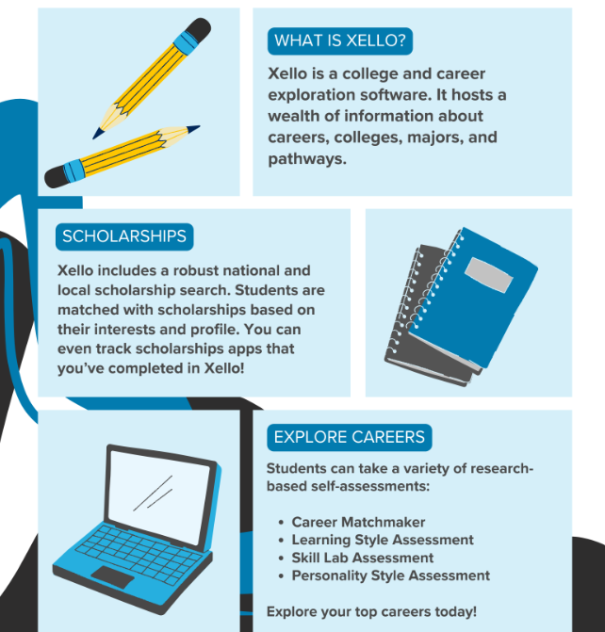

About College Planning in Xello
How do I access my Xello account?
Click the Xello Icon in your ClassLink!
Notes:
https://satsuite.collegeboard.org/sat/dates-deadlines

Slide 28



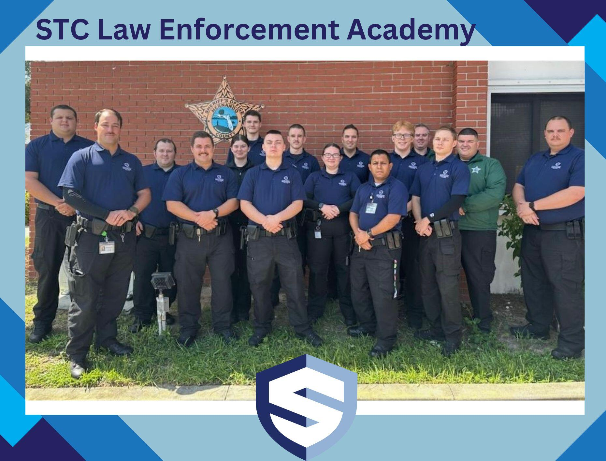
Wilton Simpson Technical College
Interested in staying local or a Technical career?
Check out Wilton Simpson
Technical College!
Learn more about STC
Notes:
https://satsuite.collegeboard.org/sat/dates-deadlines

Slide 29

Withlacoochee Technical College
Learn more about WTC
Notes:
https://wtc.citrusschools.org/

Slide 30


Pasco Hernando State College
Location information
Notes:
https://phsc.edu/

Slide 31
Scholarship Opportunities
College is expensive. There’s tuition, room and board, books, food...it all adds up fast! The following list provides information about where to find scholarships:
• Check Xello often or contact your school counselor for a copy of the scholarship matrix. The scholarship matrix can also be found on the district website.
• Participate in CollegeBoard’s Big Future Scholarships program: https://bigfuture.collegeboard.org/
• Check college websites. Many universities offer merit scholarships. These are typically posted under “financial aid” or “scholarships.” Check early: deadlines are typically during 1st semester.
• Check other scholarship search engines such as: Xello Accessible through Class link! www.scholarships360.org, www.scholarships.com, www.cappex.com
• Hernando Education Foundation offers many scholarships for Hernando County seniors. The application will open in October or November:
• Apply for Bright Futures starting October 1st of your senior year. You must submit the application before graduation. You can apply before meeting all the requirements.
Directions: Go to www.floridastudentfinancialaidsg.org
Click on the following links:
“First Time Applicants”
“Create a Student Account”
Complete the required fields
Click Submit
SAVE the Username and Password automatically generated for you. You will use this to log back in and check on the
status of your application once it has been submitted.
Fill out the Florida Financial Aid Application (FFAA)
• ROTC Scholarships through various branches of the military. These scholarships can potentially be
full tuition scholarships and have various test score and GPA requirements.
• Make sure to follow scholarship directions and be aware of deadlines. Type all parts of applications
(essay, resume, etc.). Make copies and keep on file.

Slide 32
Important Websites:
Entrance Exam Practice and Registration Sites:
www.collegeboard.org (PSAT, SAT, SAT Subject Tests)
https://www.khanacademy.org/digital-sat (SAT)
https://www.act.org/content/act/en/products-and-
services/the-act/test-preparation/free-act-test-prep.html
(ACT) www.act.org
College Information Sites:
http://bigfuture.collegeboard.org
https://www.imfirst.org
Xello
Military Sites/ROTC
Scholarship Information:
https://www.floridastudentfinancialaidsg.org/SAPHome/SAPHome?url=home.#:~:text=First-Time%20Applicants.%20Students%20must%20submit%20a%20completed%20Florida
Florida Student Scholarship & Grant Programs
https://www.floridastudentfinancialaidsg.org/SAPHome/SAPHome?url=home.#:~:text=First-Time%20Applicants.%20Students%20must%20submit%20a%20completed%20Florida
Scam Alert Information:
If you encounter one these scenarios do not pursue that avenue for college assistance
The scholarship is guaranteed or your money back.
DO NOT give your credit card information or bank account number to hold a scholarship EVER!
You hear, “we will do all the work for you”
The Scholarship costs money
Do not believe you were selected or “ You are a finalist in a contest” that you did not enter
You get an appointment time to see someone that you did not set
Notes:
https://www.floridastudentfinancialaidsg.org/SAPHome/SAPHome?url=home.#:~:text=First-Time%20Applicants.%20Students%20must%20submit%20a%20completed%20Florida

Slide 33







Military Sites / ROTC
U.S. Air Force | https://www.airforce.com
U.S. Army | https://www.army.mil
U. S. Coast Guard | https://www.uscg.mil
U.S. Navy | https://www.navy.com
U.S. Marines | https://www.marines.mil
U.S. Space Force | https://www.spaceforce.mil

Slide 34
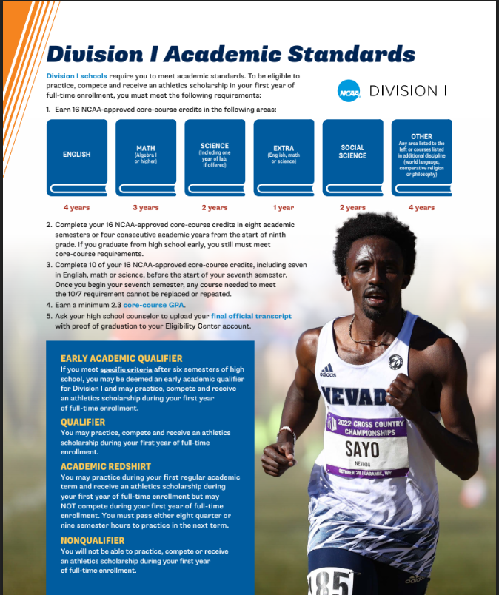
Division 1
Academic Standards
NCAA Core-Course GPA information
NCAA Core-Course GPA information
NCAA Final official transcript information
Notes:
https://satsuite.collegeboard.org/sat/dates-deadlines

Slide 35
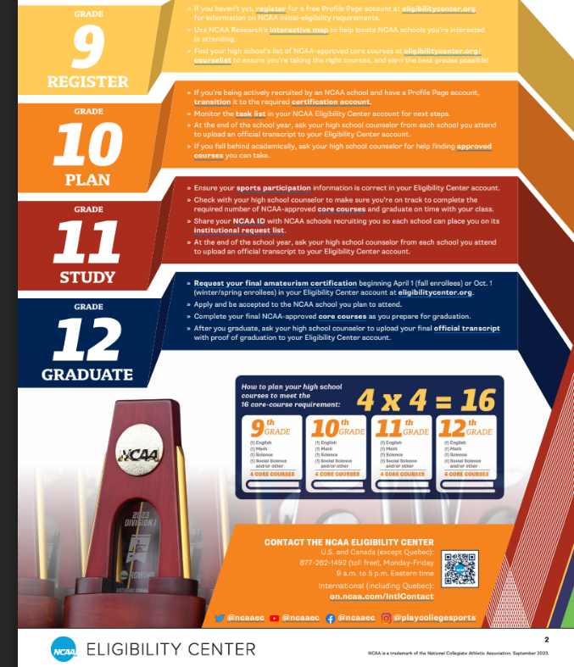
Division I Eligibility
NCAA Eligibility Center information can be accessed at the following link:
NCAA Eligibility Center information
(http://fs.ncaa.org/Docs/eligibility_center/Student_Resources/DI_ReqsFactSheet.pdf)
Notes:
https://satsuite.collegeboard.org/sat/dates-deadlines

Slide 36
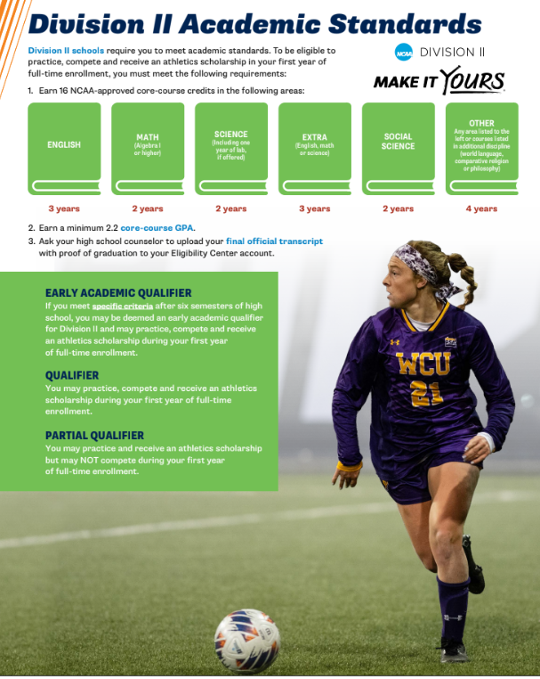
Division 2
Academic Standards
NCAA Division II schools
2.2 Core-Core GPA
Final Official transcript
Notes:
https://satsuite.collegeboard.org/sat/dates-deadlines

Slide 37
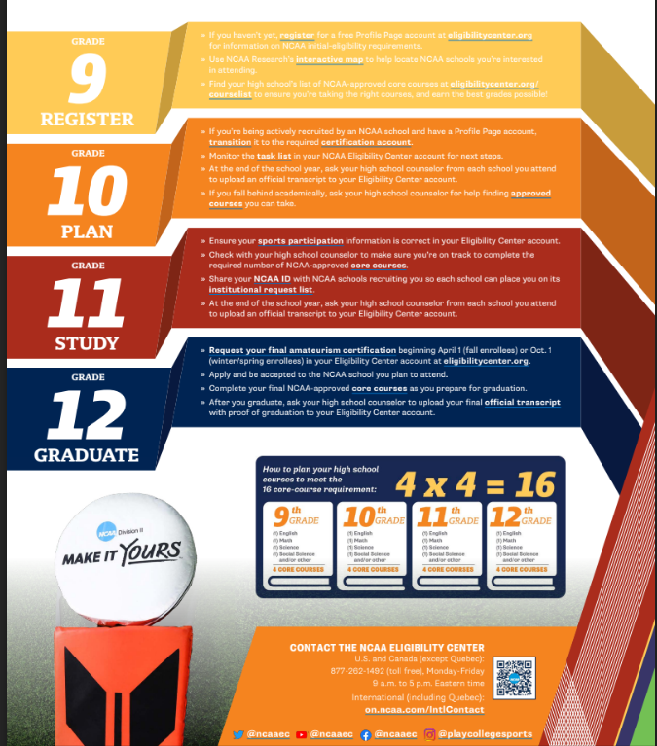
Division II Eligibility
NCAA Eligibility Center information can be accessed at the following link:
NCAA Eligibility Center information
((http://fs.ncaa.org/Docs/eligibility_center/Student_Resources/DII_ReqsFactSheet.pdf))
Notes:
https://satsuite.collegeboard.org/sat/dates-deadlines

Slide 38


NAIA Information
Why Choose the NAIA?
The NAIA is the ONLY athletic association that serves the interests of small colleges by driving student-athlete enrollment and financial sustainability. Read to learn more about the
NAIA Advantage.
The NAIA Advantage
Student-athletes come first in the NAIA. They are the inspiration that drives us to make character a core component and benefit of all intercollegiate sports.
Spend $2MM less than NCAA peers
20% of student-athletes play national-level postseason
79% of NAIA members qualify for a national championship
Flexible rules that encourage coach-student mentoring
Character-driven athletics through Champions of Character®
Learn more about the NAIA Advantage:
Finances
Analytics
Drive Enrollment & Retention
Autonomy and Flexibility
Notes:
https://satsuite.collegeboard.org/sat/dates-deadlines

Slide 39

Hernando Schools.org

